Slide 1
¿Porqué el área de un circulo es $πR^{2}$? $$π=\frac{L}{D}=3,14151.$$
Montoya.

Slide 2
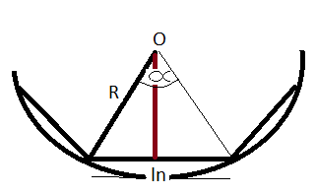
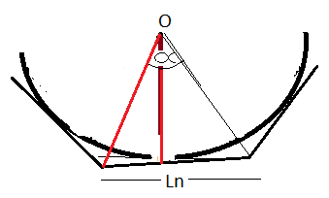
Ai= $\frac{n}{2}R^{2}sen\frac{360}{n}$
Ae= n$R^{2}sen\frac{180}{n}$

Slide 3
Ai= $\frac{4}{2}R^{2}sen\frac{360}{4}$
Ai= $\frac{5}{2}R^{2}sen\frac{360}{5}$
Ai= $\frac{6}{2}R^{2}sen\frac{360}{6}$
Ai= 2$R^{2}$
Ai= 2,37$R^{2}$
Ai= ${2,59R}^{2}$
Ae= 4$R^{2}tg\frac{180}{4}$
Ae= 5$R^{2}tg\frac{180}{5}$
Ae= 6$R^{2}tg\frac{180}{6}$
Ae= 3,63$R^{2}$
Ae= 4$R^{2}$
Ae=3,46 $R^{2}$
$$\overline{A}=3R^{2}$$
$$\overline{A}=3,18R^{2}$$
$$\overline{A}=3,02R^{2}$$

Slide 4
Para un polígono de 100 lados
Ai= $\frac{100}{2}R^{2}sen\frac{360}{100}$
Ae= 100$R^{2}tg\frac{180}{100}$
Ai= 3,13$R^{2}$
Ae= 3,14$R^{2}$
$$\overline{A}=3,14R^{2}$$

Slide 5
Para un polígono de 1000 lados
Ai= $\frac{1000}{2}R^{2}sen\frac{360}{1000}$
Ae= 1000$R^{2}tg\frac{180}{1000}$
Ai= 3,14$R^{2}$
Ae= 3,14$R^{2}$
$$\overline{A}=3,14R^{2}$$
$\overline{A}=πR^{2}$ ¡Fantástico!

Slide 6
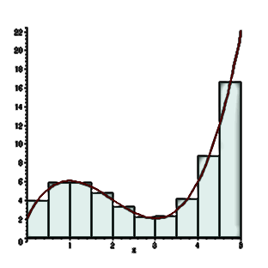
Integral de Riemann

Slide 7
Serie de Riemann
Área por aproximación
$$A_{t}=\left(0.5x1\right)+(0.5x2)+(0.5x3)+(0.5x4)$$
$A_{t}=$5$u^{2}$
0,5
f(x)=2x

Slide 8
Serie de Riemann
Área por aproximación
$A_{t}=\left(0.25x0.5\right)+\left(0.25x1\right)+ \left(0.25x1.5\right)+\left(0.25x2\right)+ \left(0.25x2.5\right)+\left(0.25x3\right)+ \left(0.25x3.5\right)+\left(0.25x4\right)$
$$A_{t}={4,5u}^{2}$$
0,25
f(x)=2x
Área Real: ${4u}^{2}$

Slide 9
Serie de Riemann
Los límites de la función $\left[a\right.,\left.b\right]$ son: $\left[0\right.,\left.2\right]$
$$∆x=\frac{b−a}{n}$$
$$∆x \sum_{i=1}^{n=8}{f(x_{i}})=\frac{2−0}{8} x \sum_{i=1}^{n=8}{f(x_{i}})=$$
$$=0.25 x \left[f\left(0.25\right)+f\left(0.5\right)+f\left(0.75\right)+f\left(1\right)+f\left(1.25\right)+f\left(1.5\right)+f\left(1.75\right)+f(2)\right]$$
$$=0.25 x (0.5+1+1.5+2+2.5+3+3.5+4)$$
$$A_{t}={4,5u}^{2}$$

Slide 10
$$∆x \sum_{i=1}^{n}{f(x_{i}})=\int_{a}^{b}{f(x)dx}$$
Pero si $∆x$ →0 , $∆x$=dx
$$\int_{a}^{b}{f(x)dx}=f\left(x\right){b \atop a}=f\left(b\right)−f(a)$$

Slide 11
Deducción del Área del Círculo
$$πr^{2}$$
¿Área?
$x^{2}+y^{2}=$r

Slide 12
Ecuación estándar de un círculo: $x^{2}+y^{2}=$R
f(x) =y$=\sqrt{R^{2}−x^{2}}$
d$A_{1}$=y$∙$dx
$$A_{1}=\int_{0}^{R}{f(x)dx}$$
dx
$$A_{T}=4∙A_{1}=4\int_{0}^{R}{(\sqrt{R^{2}−x^{2}})dx}$$
$$A_{1}$$
R
x
$$α$$
$$\sqrt{R^{2}−x^{2}}$$

Slide 13
$$\sin{α}=\frac{x}{R}$$
$$A_{T}= 4\int_{0}^{R}{(\sqrt{R^{2}−x^{2}})dx}=4\int_{0}^{\frac{π}{2}}{\sqrt{R^{2}−{\left(R∙sin{α}\right)}^{2}} R∙ cos{α}∙dα}$$
$$R sin{α}=x$$
$$R∙ cos{α}∙dα=dx$$
$$=4\int_{0}^{\frac{π}{2}}{\sqrt{R^{2}(1−{\sin{α}}^{2}}) R∙ cos{α}∙dα}$$
$$A_{T}=4∙A_{1}=4\int_{0}^{R}{(\sqrt{R^{2}−x^{2}})dx}$$
$$\sin{α}=\frac{0}{R}=0$$
$$=4\int_{0}^{\frac{π}{2}}{\sqrt{R^{2}∙{\cos{α}}^{2}} R∙ cos{α}∙dα}$$
Si x=0
$$α=0$$
$$=4\int_{0}^{\frac{π}{2}}{R∙\cos{α}∙ R∙ cos{α}∙dα}$$
Si x=R
$$\sin{α}=\frac{R}{R}=1$$
$$α=\frac{π}{2}$$

Slide 14
$$=4∙R^{2}\int_{0}^{\frac{π}{2}}{{\cos{α}}^{2}dα}$$
$$=4R^{2}\left(\frac{1}{2}α+\frac{\sin{2α}}{4}\right) {\frac{π}{2} \atop 0}$$
$$=4R^{2}\left(\frac{1}{2}\frac{π}{2}+\frac{\sin{2\frac{π}{2}}}{4}\right)−4R^{2}\left(\frac{1}{2}∙0+\frac{\sin{2∙0}}{4}\right)$$
$$=4R^{2}\left(\frac{π}{4}+\frac{\sin{π}}{4}\right)−4R^{2}∙0$$
$$A_{T}= 4\int_{0}^{R}{(\sqrt{R^{2}−x^{2}})dx}=πR^{2}$$
$$=4R^{2}\frac{π}{4}$$
$$=πR^{2}$$

Slide 15
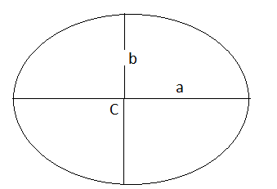
Ecuación estándar de un círculo:
$\frac{x^{2}}{a^{2}}+\frac{y^{2}}{b^{2}}=1$
f(x) =y$=\frac{b}{a}\sqrt{a^{2}−x^{2}}$
$$A=abπ$$

